Slide 1
MACHINE LEARNING
Asst.Prof.Dr. Murat ŞİMŞEK

Slide 2
Supervised Learning
Karan Kathpalia

Slide 3
Logistic Regression
Hypothesis representation
Cost function
Logistic regression with gradient descent
Regularization
Multi-class classification

Slide 4
Logistic Regression (Classification)

Slide 5
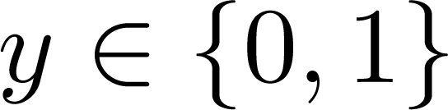
Classification
Email: Spam / Not Spam?
Online Transactions: Fraudulent (Yes / No)?
Tumor: Malignant / Benign ?
0: “Negative Class” (e.g., benign tumor)
1: “Positive Class” (e.g., malignant tumor)

Slide 6
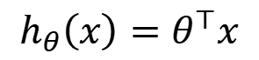
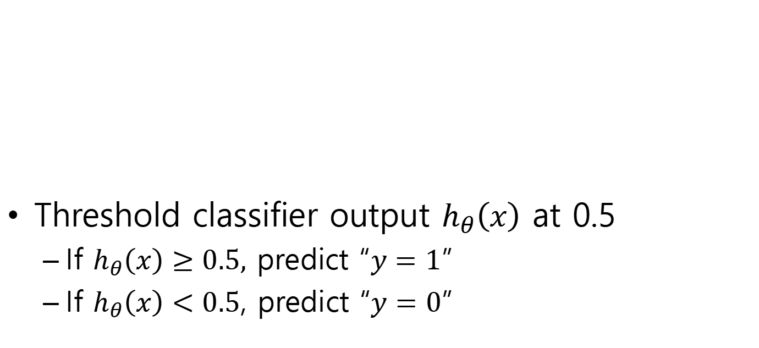
1 (Yes)
Malignant?
Threshold classifier output $h_{θ}\left(x\right)$ at 0.5
If $h_{θ}\left(x\right)≥0.5,$ predict “$y=1$”
If $h_{θ}\left(x\right)<0.5$, predict “$y=0$”
0 (No)
Tumor Size
$$h_{θ}\left(x\right)=θ^{⊤}x$$

Slide 7
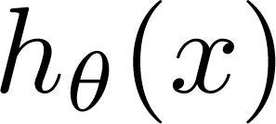
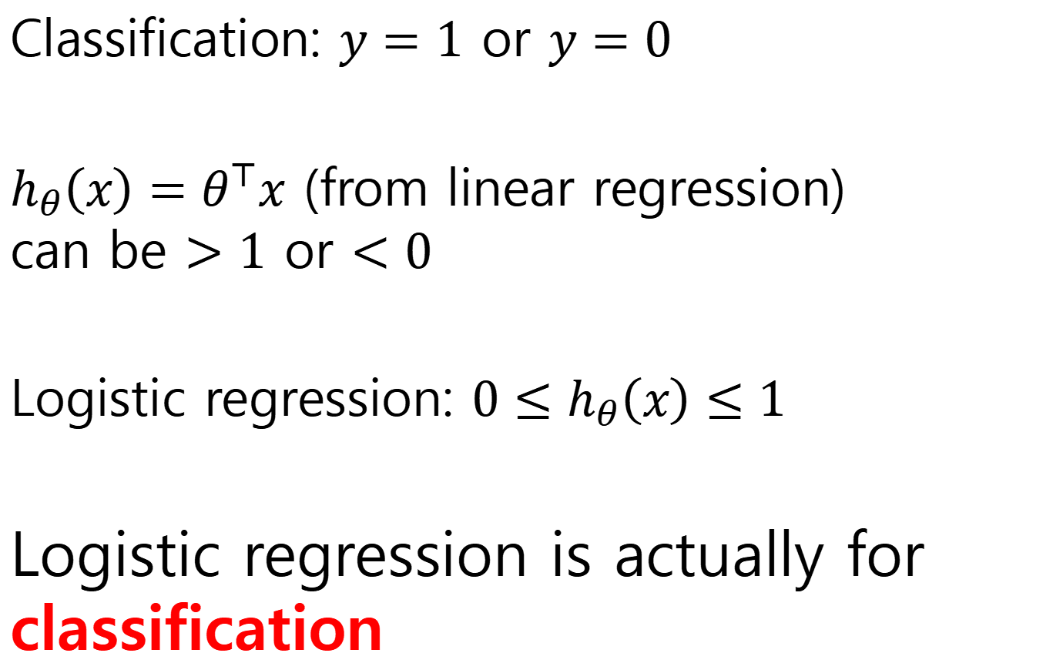
Classification: $y=1$ or $y=0$
$h_{θ}\left(x\right)=θ^{⊤}x$ (from linear regression) can be $>1$ or $<0$
Logistic regression: ${0≤h}_{θ}\left(x\right)≤1$
Logistic regression is actually for classification
can be > 1 or < 0

Slide 8

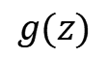
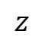
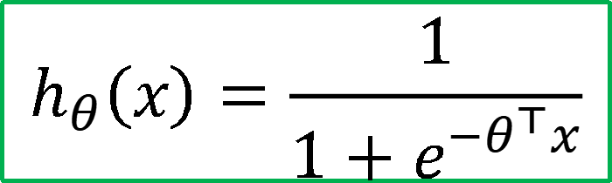
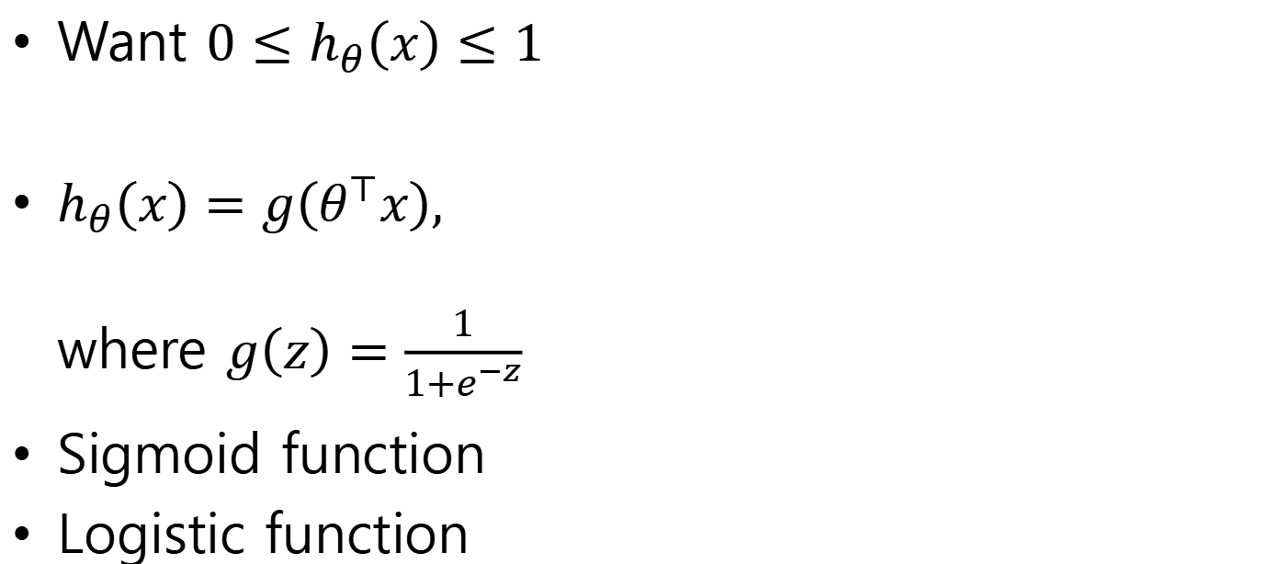
Hypothesis representation
Want ${0≤h}_{θ}\left(x\right)≤1$
$h_{θ}\left(x\right)=g\left(θ^{⊤}x\right),$ where $g\left(z\right)=\frac{1}{1+e^{−z}}$
Sigmoid function
Logistic function
$$h_{θ}\left(x\right)=\frac{1}{1+e^{−θ^{⊤}x}}$$
$$g(z)$$
$$z$$

Slide 9
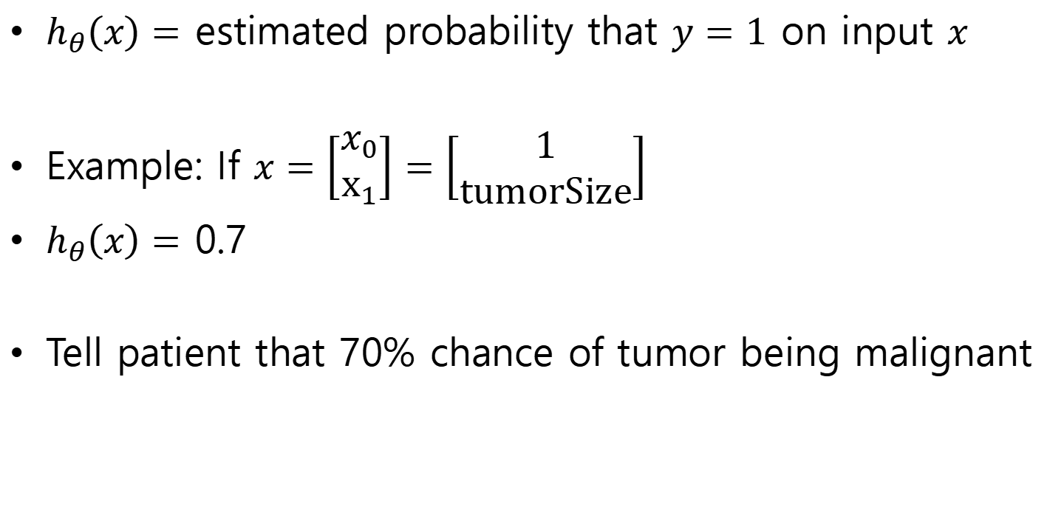
Interpretation of hypothesis output
$h_{θ}\left(x\right)=$ estimated probability that $y=1$ on input $x$
Example: If $x=\left[\begin{aligned}x_{0} \\ x_{1}\end{aligned}\right]=\left[\begin{aligned}1 \\ tumorSize\end{aligned}\right]$
$h_{θ}\left(x\right)=$ 0.7
Tell patient that 70% chance of tumor being malignant

Slide 10
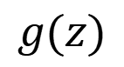
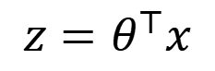
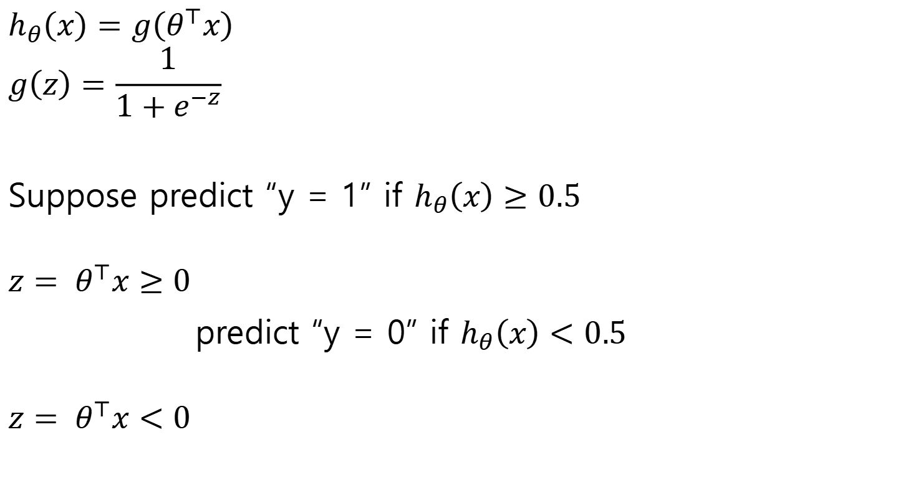
Logistic regression
$$h_{θ}\left(x\right)=g\left(θ^{⊤}x\right)$$
$$g\left(z\right)=\frac{1}{1+e^{−z}}$$
Suppose predict “y = 1” if $h_{θ}\left(x\right)≥0.5$
${z= θ}^{⊤}x≥0$
predict “y = 0” if $h_{θ}\left(x\right)<0.5$
${z= θ}^{⊤}x<0$
$$g(z)$$
$$z=θ^{⊤}x$$

Slide 11
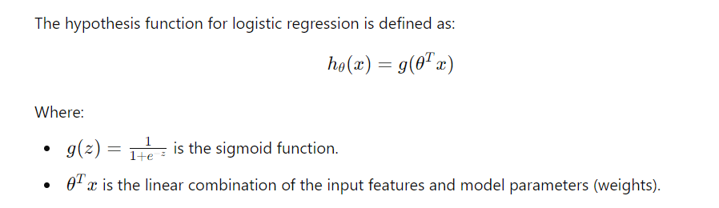
Logistic regression
$$g(z)$$
$$z=θ^{⊤}x$$

Slide 12
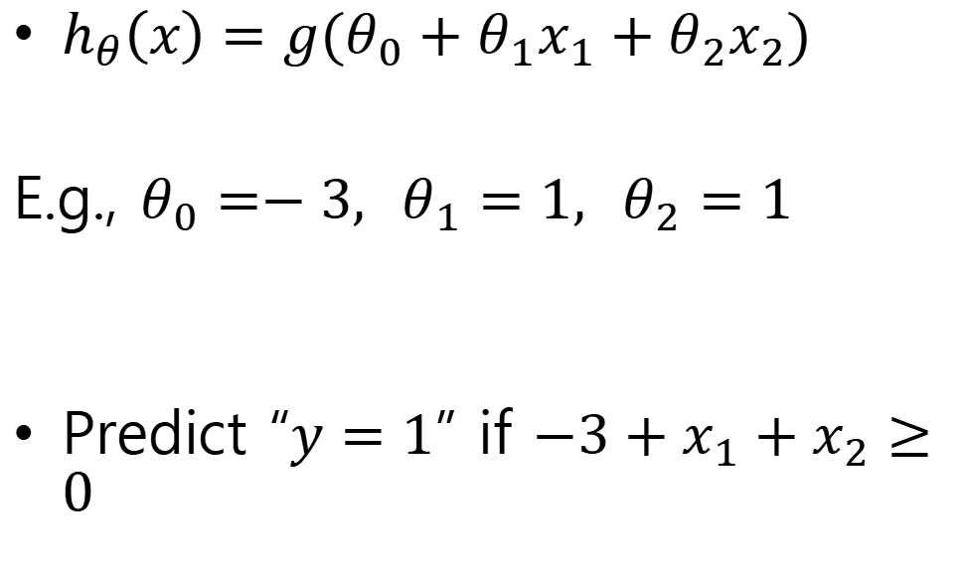
Decision boundary
$h_{θ}\left(x\right)=g(θ_{0}+θ_{1}x_{1}+θ_{2}x_{2})$
E.g., $θ_{0}=−3, { θ}_{1}=1, θ_{2}=1$
Predict “$y=1$” if $−3+x_{1}+x_{2}≥0$
Age
Tumor Size

Slide 13
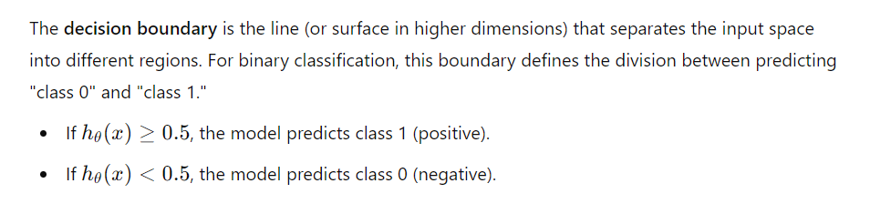
Decision boundary

Slide 14
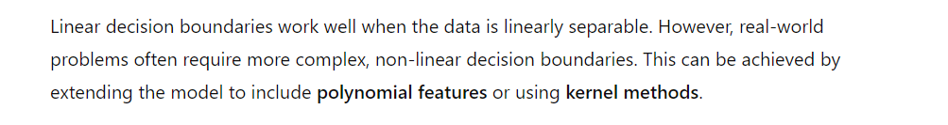
Non-Linear Decision boundary

Slide 15
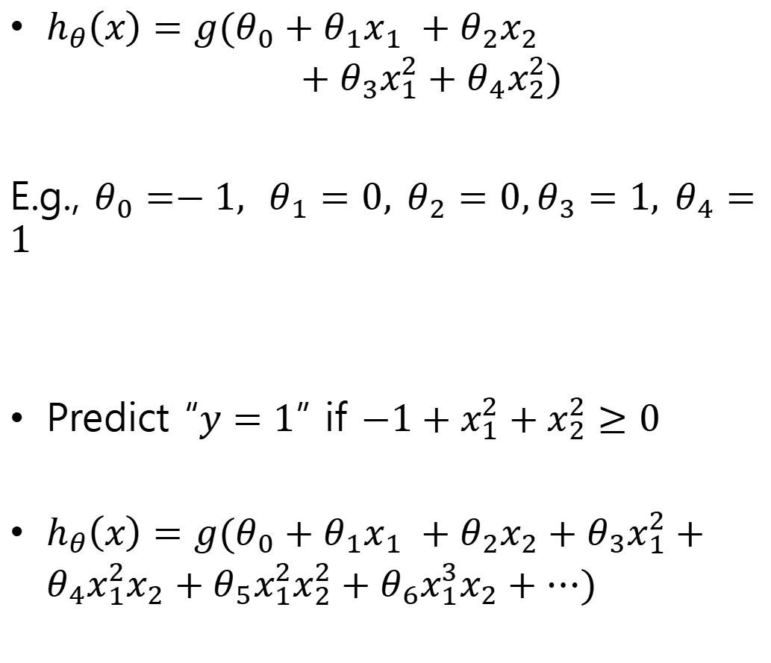
$h_{θ}\left(x\right)=g(θ_{0}+θ_{1}x_{1} +θ_{2}x_{2}$ $+$ $θ_{3}x_{1}^{2}+θ_{4}x_{2}^{2})$
E.g., $θ_{0}=−1, { θ}_{1}=0, θ_{2}=0,θ_{3}=1, θ_{4}=1$
Predict “$y=1$” if $−1+x_{1}^{2}+x_{2}^{2}≥0$
$h_{θ}\left(x\right)=g(θ_{0}+θ_{1}x_{1} +θ_{2}x_{2}+$ $θ_{3}x_{1}^{2}+θ_{4}x_{1}^{2}x_{2}+θ_{5}x_{1}^{2}x_{2}^{2}+θ_{6}x_{1}^{3}x_{2}+⋯)$

Slide 16
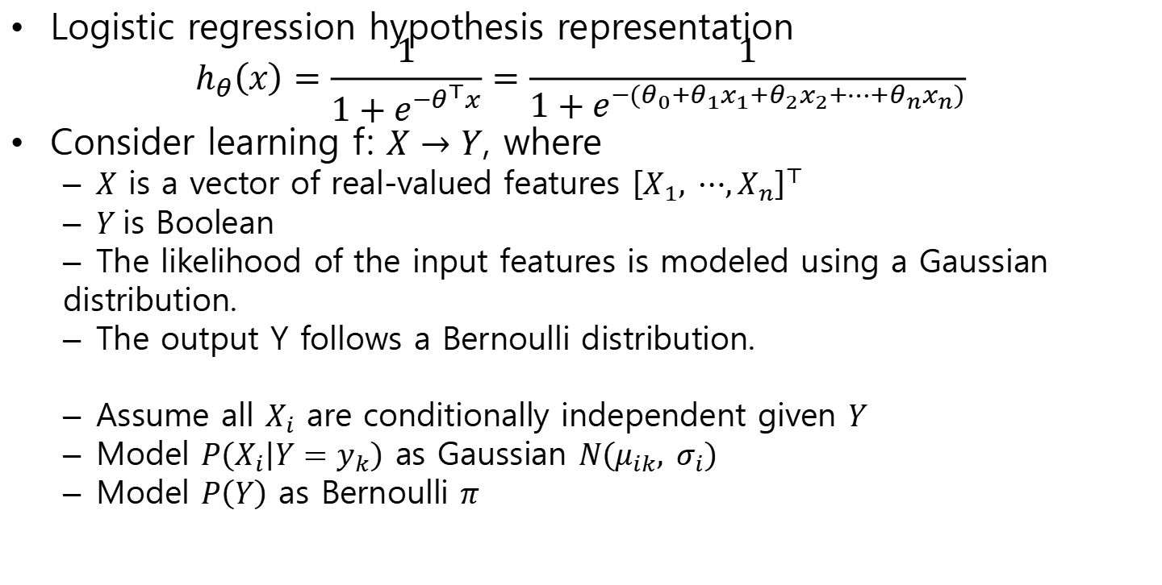
Where does the form come from?
Logistic regression hypothesis representation
$$h_{θ}\left(x\right)=\frac{1}{1+e^{−θ^{⊤}x}}=\frac{1}{1+e^{−(θ_{0}+θ_{1}x_{1}+θ_{2}x_{2}+⋯+θ_{n}x_{n})}}$$
Consider learning f: $X→Y$, where
$X$ is a vector of real-valued features ${\left[X_{1}, ⋯,X_{n}\right]}^{⊤}$
$Y$is Boolean
The likelihood of the input features is modeled using a Gaussian
distribution.
The output Y follows a Bernoulli distribution.
Assume all $X_{i}$ are conditionally independent given $Y$
Model $P\left(X_{i} | Y=y_{k}\right)$ as Gaussian $N\left(μ_{ik}, σ_{i}\right)$
Model $P\left(Y\right)$ as Bernoulli $π$

Slide 17
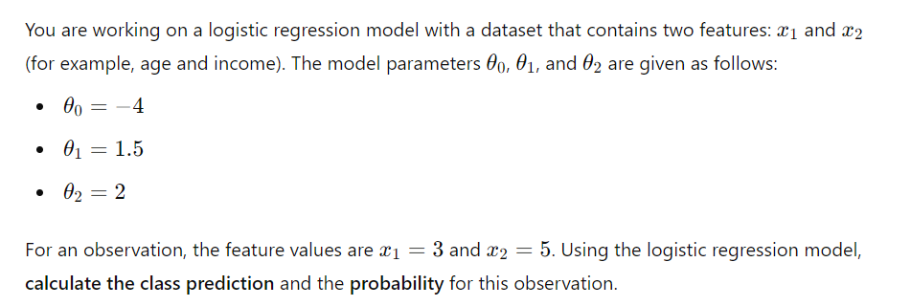
Question-1

Slide 18
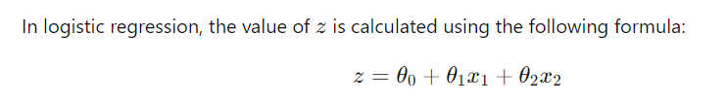
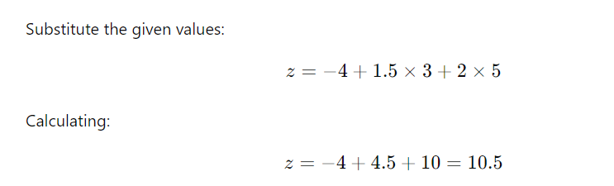
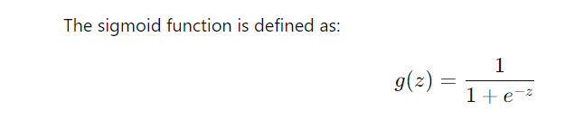
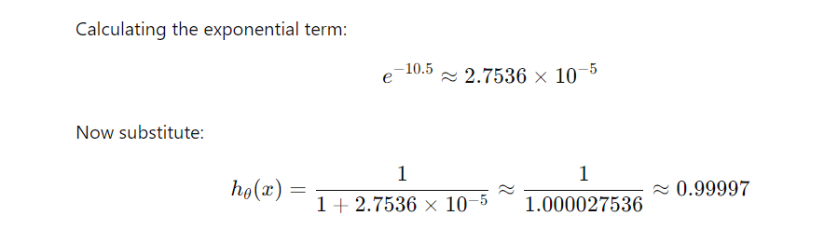
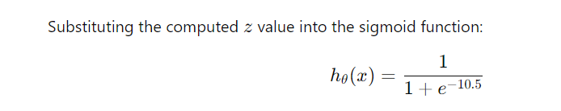
Solution-1

Slide 19
Logistic Regression
Hypothesis representation
Cost function
Logistic regression with gradient descent
Regularization
Multi-class classification

Slide 20
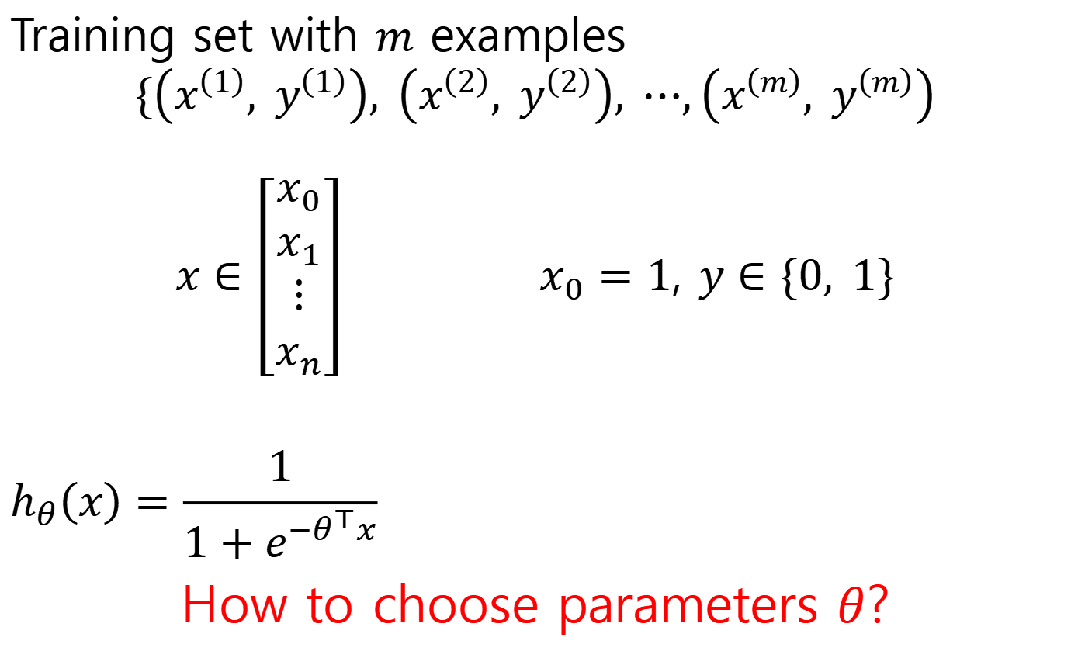
Training set with $m$ examples
$$\{\left(x^{\left(1\right)}, y^{\left(1\right)}\right), \left(x^{\left(2\right)}, y^{\left(2\right)}\right), ⋯,\left(x^{\left(m\right)}, y^{\left(m\right)}\right)$$
$x∈\left[\begin{aligned}x_{0} \\ x_{1} \\ ⋮ \\ x_{n}\end{aligned}\right]$ $x_{0}=1$, $y∈\{0, 1\}$
$$h_{θ}\left(x\right)=\frac{1}{1+e^{−θ^{⊤}x}}$$
How to choose parameters $θ$?

Slide 21
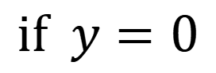
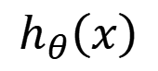
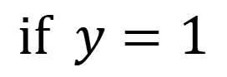
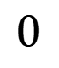
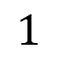
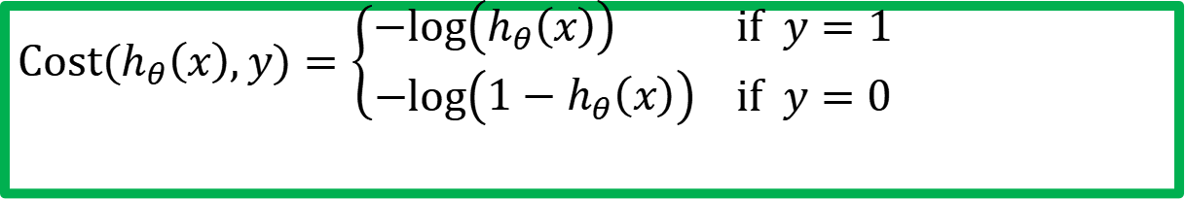
Cost function for Logistic Regression
$$Cost(h_{θ}\left(x\right),y)=\left\{\begin{aligned}−log\left(h_{θ}\left(x\right)\right) if y=1 \\ −log\left({1−h}_{θ}\left(x\right)\right) if y=0\end{aligned}\right.$$
$$if y=1$$
$$if y=0$$
$$0$$
$$h_{θ}\left(x\right)$$
$$1$$
$$0$$
$$h_{θ}\left(x\right)$$
$$1$$

Slide 22
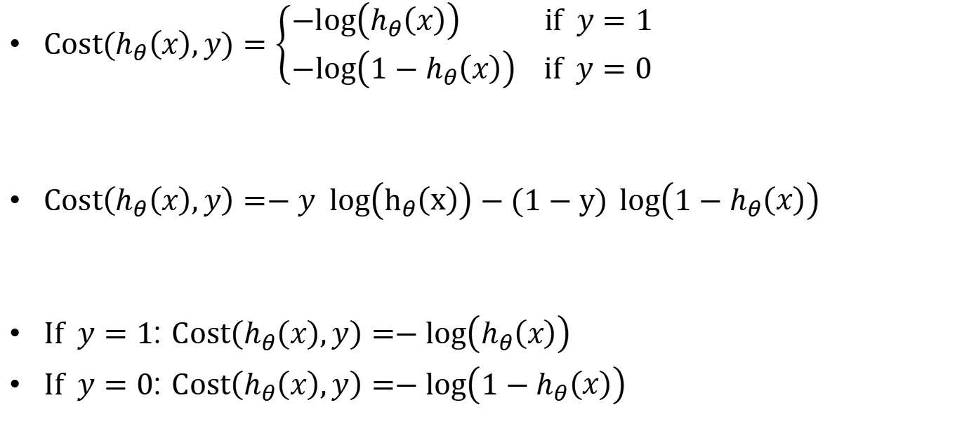
Logistic regression cost function
$Cost(h_{θ}\left(x\right),y)=\left\{\begin{aligned}−log\left(h_{θ}\left(x\right)\right) if y=1 \\ −log\left({1−h}_{θ}\left(x\right)\right) if y=0\end{aligned}\right.$
$Cost\left(h_{θ}\left(x\right),y\right)=−y log\left(h_{θ}\left(x\right)\right)−(1−y)$ $log\left({1−h}_{θ}\left(x\right)\right)$
$If y=1$: $Cost\left(h_{θ}\left(x\right),y\right)=−log\left(h_{θ}\left(x\right)\right)$
$If y=0$: $Cost\left(h_{θ}\left(x\right),y\right)=−log\left({1−h}_{θ}\left(x\right)\right)$

Slide 23
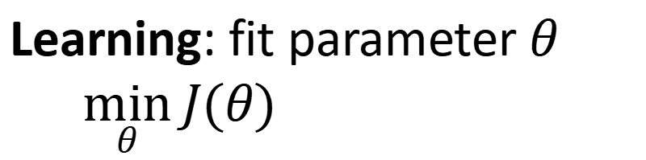
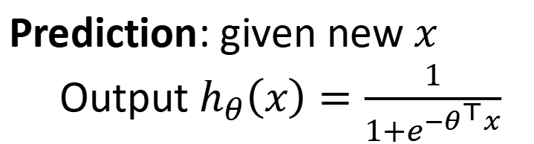
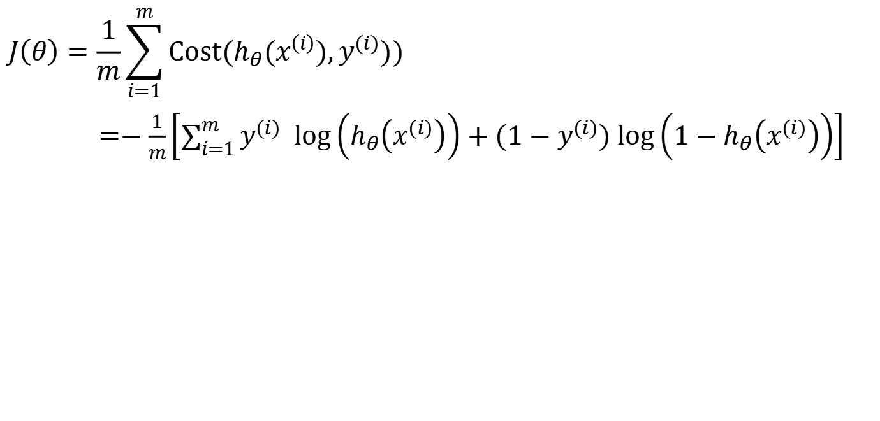
Logistic regression
$$J\left(θ\right)=\frac{1}{m}\sum_{i=1}^{m}{Cost(h_{θ}(x^{\left(i\right)}),y^{(i)}))}$$
$=−\frac{1}{m}\left[\sum_{i=1}^{m}{y^{(i)} log\left(h_{θ}\left(x^{(i)}\right)\right)+(1−y^{(i)}) log\left({1−h}_{θ}\left(x^{(i)}\right)\right)}\right]$
Learning: fit parameter $θ$
$\min_{θ}{J(θ)}$
Prediction: given new $x$
Output $h_{θ}\left(x\right)=\frac{1}{1+e^{−θ^{⊤}x}}$

Slide 24
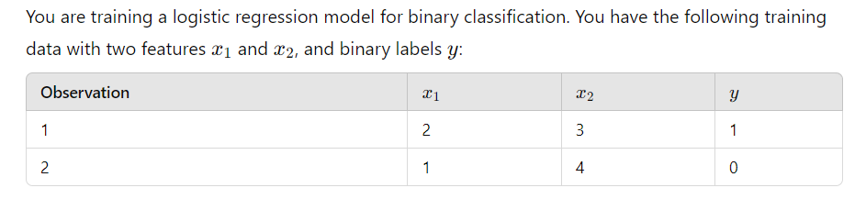
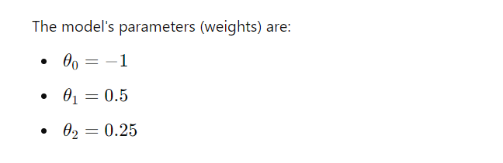
Question-2
Calculate cost function of logistic regression in this question.

Slide 25
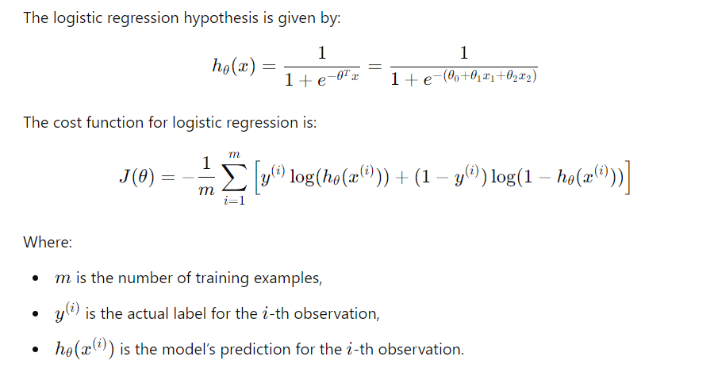
Solution-2

Slide 26
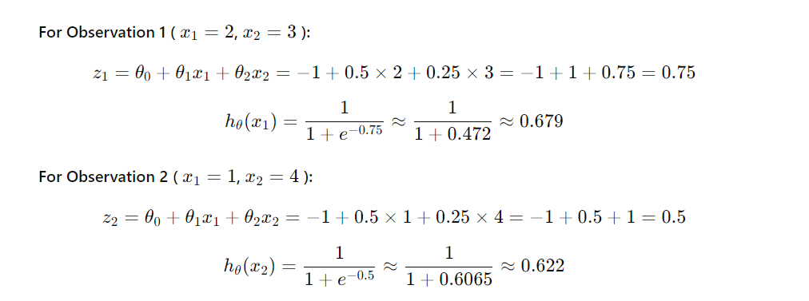
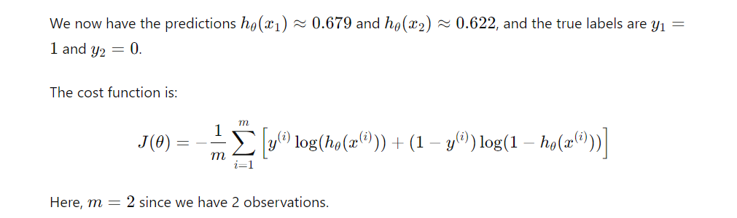
Solution-2

Slide 27
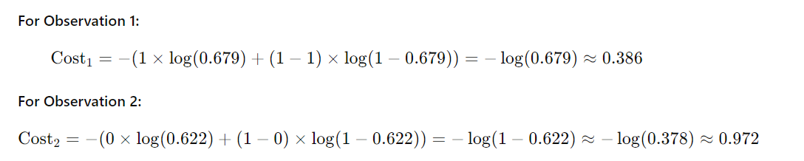
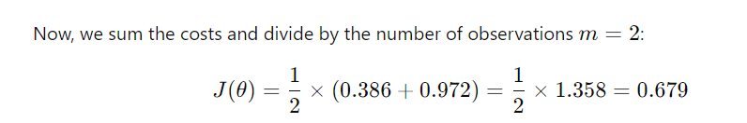
Solution-2

Slide 28
Logistic Regression
Hypothesis representation
Cost function
Logistic regression with gradient descent
Regularization
Multi-class classification

Slide 29
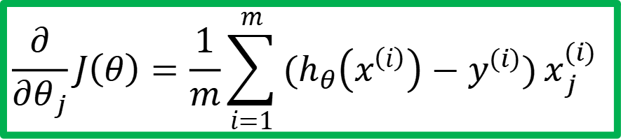
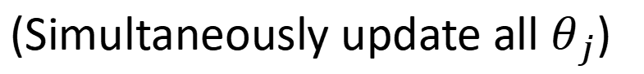
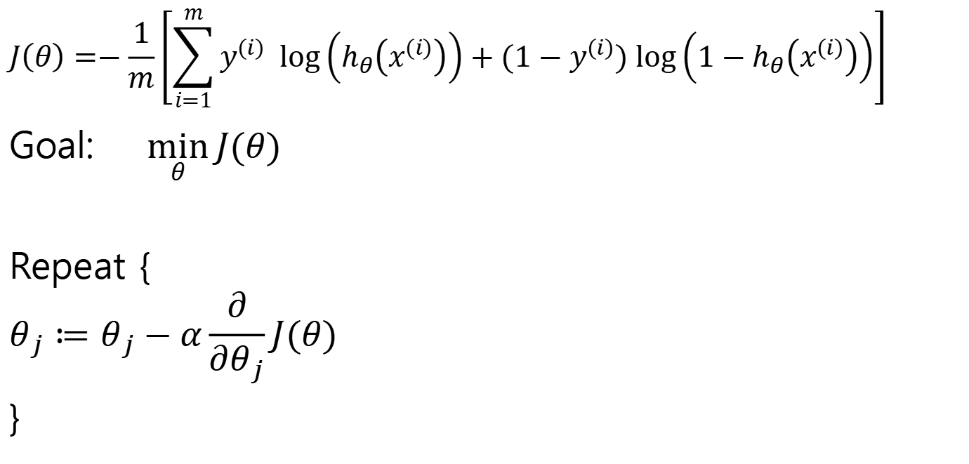
Gradient descent
$$J\left(θ\right)=−\frac{1}{m}\left[\sum_{i=1}^{m}{y^{(i)} log\left(h_{θ}\left(x^{(i)}\right)\right)+(1−y^{(i)}) log\left({1−h}_{θ}\left(x^{(i)}\right)\right)}\right]$$
Goal: $\min_{θ}{J(θ)}$
Repeat {
$$θ_{j}≔θ_{j}−α\frac{∂}{∂θ_{j}}J(θ)$$
}
Good news: Convex function!
Bad news: No analytical solution
(Simultaneously update all $θ_{j}$)
$$\frac{∂}{∂θ_{j}}J\left(θ\right)=\frac{1}{m}\sum_{i=1}^{m}{(h_{θ}\left(x^{\left(i\right)}\right)−y^{(i)})}x_{j}^{(i)}$$

Slide 30
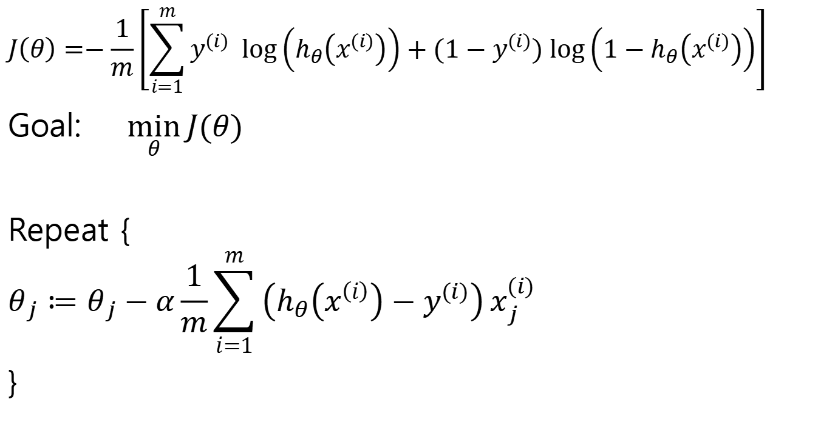
Gradient descent
$$J\left(θ\right)=−\frac{1}{m}\left[\sum_{i=1}^{m}{y^{(i)} log\left(h_{θ}\left(x^{(i)}\right)\right)+(1−y^{(i)}) log\left({1−h}_{θ}\left(x^{(i)}\right)\right)}\right]$$
Goal: $\min_{θ}{J(θ)}$
Repeat {
$$θ_{j}≔θ_{j}−α\frac{1}{m}\sum_{i=1}^{m}{\left(h_{θ}\left(x^{\left(i\right)}\right)−y^{(i)}\right)}x_{j}^{(i)}$$
}
(Simultaneously update all $θ_{j}$)

Slide 31
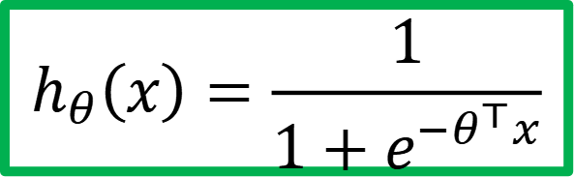
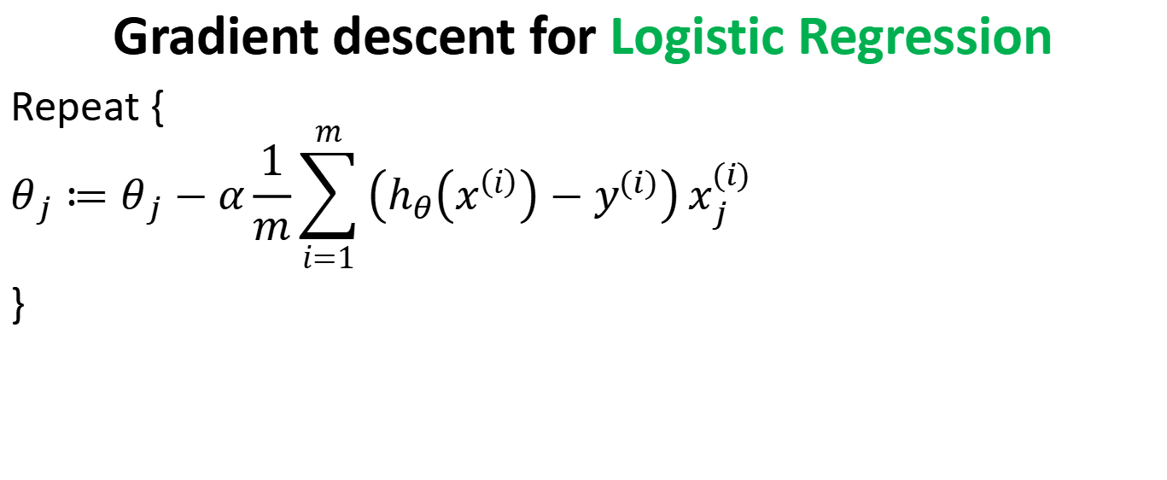
Gradient descent for Logistic Regression
Repeat {
$$θ_{j}≔θ_{j}−α\frac{1}{m}\sum_{i=1}^{m}{\left(h_{θ}\left(x^{\left(i\right)}\right)−y^{(i)}\right)}x_{j}^{(i)}$$
}
$$h_{θ}\left(x\right)=\frac{1}{1+e^{−θ^{⊤}x}}$$

Slide 32
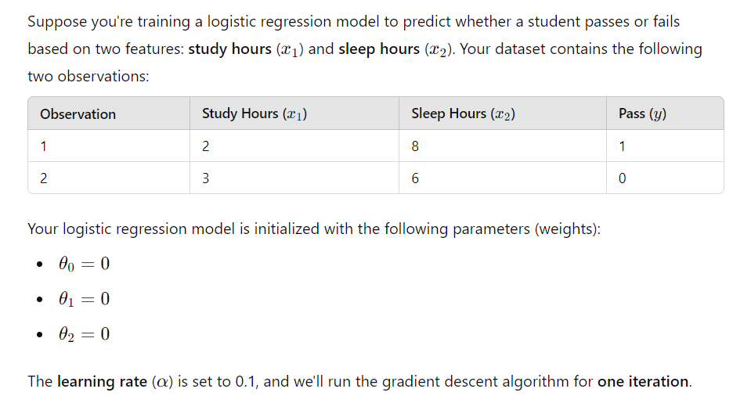
QUESTION-3
Calculate parameters of parameters after one iteration of gradient descent

Slide 33


Solution-3

Slide 34


Solution-3

Slide 35


Solution-3

Slide 36

Solution-3

Slide 37
Logistic Regression
Hypothesis representation
Cost function
Logistic regression with gradient descent
Regularization
Multi-class classification

Slide 38
Multi-class classification
Email foldering/taggning: Work, Friends, Family, Hobby
Medical diagrams: Not ill, Cold, Flu
Weather: Sunny, Cloudy, Rain, Snow

Slide 39


Binary classification
Multiclass classification
$$x_{2}$$
$$x_{2}$$
$$x_{1}$$
$$x_{1}$$

Slide 40






One-vs-all (one-vs-rest)
$$x_{2}$$
$$h_{θ}^{\left(1\right)}\left(x\right)$$
$$x_{1}$$
$$x_{2}$$
$$x_{2}$$
$$h_{θ}^{\left(2\right)}\left(x\right)$$
$$x_{1}$$
$$x_{1}$$
Class 1:
Class 2:
Class 3:
$$h_{θ}^{\left(3\right)}\left(x\right)$$
$$x_{2}$$
$$h_{θ}^{\left(i\right)}\left(x\right)=P\left(y=i | x;θ\right) (i=1, 2, 3)$$
$$x_{1}$$

Slide 41

One-vs-all
Train a logistic regression classifier $h_{θ}^{\left(i\right)}\left(x\right)$ for each class $i$ to predict the probability that $y=i$
Given a new input $x$, pick the class $i$that maximizes
$\max_{i}$ $h_{θ}^{\left(i\right)}\left(x\right)$

Slide 42





Things to remember
Hypothesis representation
Cost function
Logistic regression with gradient descent
Regularization
Multi-class classification
$$h_{θ}\left(x\right)=\frac{1}{1+e^{−θ^{⊤}x}}$$
$$Cost(h_{θ}\left(x\right),y)=\left\{\begin{aligned}−log\left(h_{θ}\left(x\right)\right) if y=1 \\ −log\left({1−h}_{θ}\left(x\right)\right) if y=0\end{aligned}\right.$$
$$θ_{j}≔θ_{j}−α\frac{1}{m}\sum_{i=1}^{m}{\left(h_{θ}\left(x^{\left(i\right)}\right)−y^{(i)}\right)}x_{j}^{(i)}$$
$$θ_{j}≔θ_{j}−αλθ_{j}−α\frac{1}{m}\sum_{i=1}^{m}{\left(h_{θ}\left(x^{\left(i\right)}\right)−y^{(i)}\right)}x_{j}^{(i)}$$
$\max_{i}$ $h_{θ}^{\left(i\right)}\left(x\right)$

Slide 43
Nonlinear Regression and Classification Algorithms

Slide 44
(KNN) K-Nearest Neighbors Algorithm

Slide 45


(KNN) K-Nearest Neighbors
K-Nearest Neighbor is a supervised learning algorithm both for classification and regression.
The principle is to find the predefined number of training samples closest to the new point, and predict the label from these training samples.

Slide 46
What is k in KNN?
The parameter k in kNN refers to the number of neighbors considered for classification or regression.
The value of k indicates the number of these points used to determine the result.
Our task is to calculate the distance and identify which categories or values are closest to our unknown entity.

Slide 47
1-Nearest Neighbor
The parameter k in kNN refers to the number of labeled points (neighbors) considered for classification or regression

Slide 48
3-Nearest Neighbor

Slide 49



KNN

Slide 50
How is the k-distance calculated?
K-distance is the distance between data points and a given query point.
To calculate it, we have to pick a distance metric:
Euclidean distance
Manhattan distance
Minkowski distance
Hamming distance

Slide 51


Euclidean distance
The Euclidean distance between two points is the length of the straight line segment connecting them.
This most common distance metric is applied to real-valued vectors.

Slide 52


Manhattan distance
The Manhattan distance between two points is the sum of the absolute differences between the x and y coordinates of each point.

Slide 53

Hamming distance
Hamming distance is used to compare two binary vectors (also called data strings or bitstrings).
To calculate it, data first has to be translated into a binary system.

Slide 54

How does K-NN work?
The K-NN working can be explained on the basis of the below algorithm:
Step-1: Select the number K of the neighbors
Step-2: Calculate the distance of K number of neighbors
Step-3: Take the K nearest neighbors as per the calculated distance
Step-4: Among these k neighbors, count the number of the data points in each category.
Step-5: Assign the new data points to that category for which the number of the neighbor is maximum.
Step-6: Our model is ready.

Slide 55

QUESTION

Slide 56

ANSWER

Slide 57

ANSWER

Slide 58
(SVM) Support Vector Machine

Slide 59
Types of SVM
SVM can be of two types:
Linear SVM: Linear SVM is used for linearly separable data, which means if a dataset can be classified into two classes by using a single straight line, then such data is termed as linearly separable data, and classifier is used called as Linear SVM classifier.
Non-linear SVM: Non-Linear SVM is used for non-linearly separated data, which means if a dataset cannot be classified by using a straight line, then such data is termed as non-linear data and classifier used is called as Non-linear SVM classifier.

Slide 60
(SVM) Support Vector Machine
Support Vector Machine or SVM is one of the most popular Supervised Learning algorithms, which is used for Classification as well as Regression problems.
The goal of the SVM algorithm is to create the best line or decision boundary that can segregate n-dimensional space into classes so that we can easily put the new data point in the correct category in the future.
This best decision boundary is called a hyperplane.

Slide 61

(SVM) Support Vector Machine

Slide 62
(SVM) Support Vector Machine
SVM chooses the extreme points/vectors that help in creating the hyperplane.
These extreme cases are called as support vectors, and hence algorithm is termed as Support Vector Machine.
Consider the below diagram in which there are two different categories that are classified using a decision boundary or hyperplane:

Slide 63

How do we find the right hyperplane?
How do we best segregate the two classes within the data?
The distance between the hyperplane and the nearest data point from either set is known as the margin.
The goal is to choose a hyperplane with the greatest possible margin between the hyperplane and any point within the training set, giving a greater chance of new data being classified correctly.
There will never be any data point inside the margin.

Slide 64
How do we find the right hyperplane?
“Select the hyper-plane which segregates the two classes better”.

Slide 68
Any of these would be fine..
..but which is best?

Slide 69





Large-margin Decision Boundary
The decision boundary should be as far away from the data of both classes as possible
We should maximize the margin, m
Distance between the origin and the line w^{t}x=-b is b/||w||
Class 2
m
Class 1

Slide 70
Finding the Decision Boundary
Let {x₁, ..., x_{n}} be our data set and let y_{i} ∈ {1,-1} be the class label of x_{i}
The decision boundary should classify all points correctly ⇒
To see this: when y=-1, we wish (wx+b)<1, when y=1, we wish (wx+b)>1. For support vectors, we wish y(wx+b)=1.
The decision boundary can be found by solving the following constrained optimization problem

Slide 71

question

Slide 72

answer

